Slide 1
Need for Environmental Justice in the Management of the Missouri River by the Army Corps of Engineers
Peter Capossela
Attorney at Law PC
Post Office Box 10643
Eugene, Oregon 97440
pcapossela@nu-world.com

Slide 3
Indian Water Rights
Reserved in Treaties and other agreements with United States.
In an amount sufficient to fulfill the purpose of the establishment of the Reservation – that it be a permanent homeland. Includes present and future uses.
States and non-Indian water users pressure Tribes to “quantify” the amount of water Tribes are entitled.
“First in time, first in right” principle of water law recognizes that Tribal water rights are senior to those who came later.
Failure of U.S. to protect Tribal water uses.

Slide 4
Future Water Uses
Arizona v. California – U.S. Supreme Court recognized Indian reserved water right in a quantity “to satisfy the future as well as the present needs of the Indian reservations...” 373 U.S. 546, 596 (1963)
Purpose of 1868 Fort Laramie Treaty - under Article XV, “they will regard said reservation their permanent home, and they will make no permanent settlement elsewhere; but they shall have the right, subject to the conditions and modifications of this treaty, to hunt, as stipulated in Article XI.”
Permanent homeland standard includes an extensive reserved water right for all beneficial uses, including MR & I; cultural and ceremonial uses; fish and wildlife; agriculture; energy and other uses

Slide 5
Threats to water rights for future uses on the Indian Reservations in the Great Plains
Army Corps of Engineers mismanagement of stream flows and violations of environmental justice at the Missouri River main stem dams
Water demand and proposals for future growth – Red River Valley Water Importation Plan; West River Water Development District Missouri River Pipeline Project
Out of basin demands – water supply, Mississippi R. navigation
Definition of Waters of the United States

Slide 6
Important Considerations – Missouri R.
Indian water rights are Treaty rights. Infringement of water rights are Treaty violations.
Environmental justice requires water justice.
Impacts to subsistence hunting and fishing by Tribal members.
Water quality concerns – high-capacity oil and gas pipelines.
Impacts of dam operations on cultural resources.

Slide 7
Regulation of Missouri River Water Flows under the Master Manual
Supply water flow for downstream navigation, March 15 - Nov. 15 w/ full service 35,000 cfs.
Supply water flow for hydropower, and downstream water supply, Nov. 16 - March 14 w/ full service 17,000 cfs.
System releases for ice jams in winter, peak hydropower, evacuation for flood control storage
ESA flows / ESH – MRRIC violated 2007 WRDA, ESA
http://www.nwdmr.usace.army.mil/rcc/reports/mmanual/MasterManual.pdf

Slide 8
Executive Order 12898 Environmental Justice for Minority and Low Income Communities
“Each Federal agency shall make achieving environmental justice part of its mission by identifying and addressing, as appropriate, disproportionately high and adverse human health or environmental effects of its programs, policies and activities.” sec. 1-101
“Federal agencies… shall collect, maintain, and analyze information on the consumptive patterns of populations who principally rely on fish and/or wildlife for subsistence.” sec. 4-401
Executive Order 12898 on Environmental Justice
59 Fed. Reg. 7629 (Feb. 16, 1994)

Slide 9
Missouri R. Operations by Corps of Engineers – Issues Arising from Master Manual
Impacts to Tribes – water supply, erosion, infrastructure, fish & wildlife habitat, cultural resources, flooding of homes
Downstream demand for water – navigation and water intakes
Upstream demand for water – hydraulic fracturing, municipal uses
Out of basin demands – Army Corps of Engineers Surplus Water Reports
Risk to water quality – oil and gas development

Slide 10
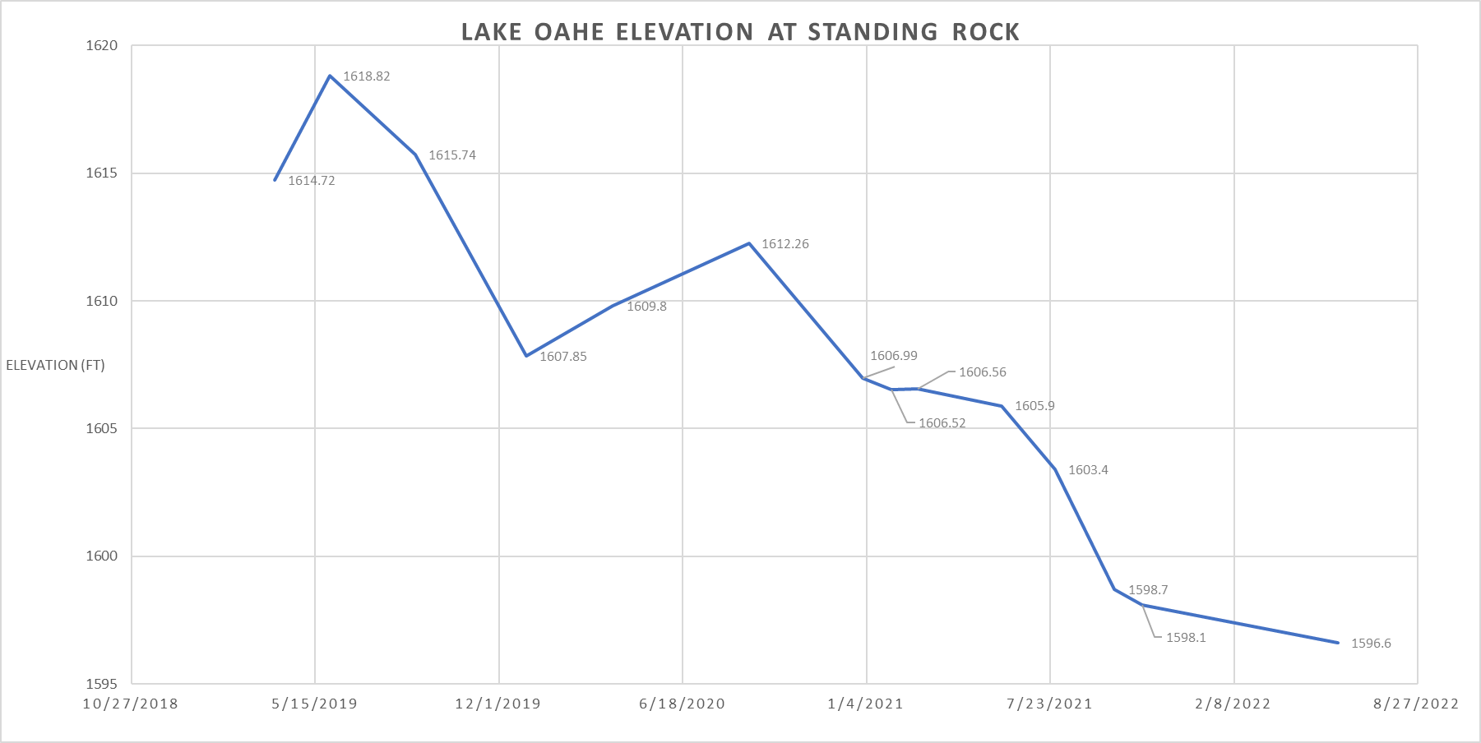

Slide 11
What is the Corps’ obligation to affected Tribes?
“In order to fulfill his fiduciary obligation, the Secretary must ensure, to the extent of his power, that all water not obligated by court decree or contract goes to the [Pyramid Lake Reservation.]”
“The Secretary was obligated to formulate a closely developed regulation that could preserve water for the Tribe.”
Pyramid Lake Paiute Tribe v. Morton,
417 U.S. 252, 256 (D.D.C. 1972

Slide 12
Missouri River Master Manual
“Oahe’s primary water management functions are
to capture plains snowmelt and localized rainfall runoffs… that are then metered out at controlled release rates to meet System requirements…
to serve as primary storage location… (for) downstream flood control…
to provide the extra water needed to meet project purposes that draft storage in low-water years, particularly downstream water supply and navigation.”
p. VII-1.

Slide 13
Corps’ Operations under the Master Manual Infringe on Indian Water Rights
“E.06-3 Tribal Water Rights. Native American water rights are rights to divert water from a stream for beneficial use. When a Tribe exercises its water rights, these consumptive uses will be incorporated into the system as an existing depletion. Accordingly, water must actually be diverted to have an impact on the operation of the system. Further modification to system operation, in accordance with pertinent legal requirements, will be considered as Tribal water rights are exercised.”

Slide 14
It’s worth repeating: Indian water rights are Treaty rights
“Agencies shall respect Indian Tribal self government and sovereignty, honor tribal treaty and other rights, and strive to meet the responsibilities that arise from the unique relationship between the Federal government and Indian tribal governments.”
Executive Order 13175 on Consultation and Coordination with Indian Tribal Governments, sec. 3(a) (65 Fed. Reg. 67249-67250 (Nov. 9, 2000))

Slide 15
Corps’ Operations under the Master Manual Infringe on Indian Water Rights
The water supplied for downstream navigation and water intakes are subject to tribal water claims.
Tribal water intakes impacted, on-Res water use diminished
Water for fish and wildlife – Environmental Justice
Downstream navigation, municipal water intakes and power plants invested $ in reliance on continued flows – forces of the status quo
Uncertainty over water supply affects feasibility of future Tribal water projects. (See 55 Fed. Reg. 9223, May 12, 1990).

Slide 16
Dept. of the Army proposed “Modernization of the flood control program”
Announced in federal register on June 3, 2022 – Tribal consultation policy, Tribal Partnership grant program, 33 CFR Part 325 App. C, review of “Principles, Requirements & Guidelines” 87 Fed. Reg. 33756
Army Civil Works held 6 virtual Tribal meetings & 6 public meetings
Received public comment until August 2, 2022

Slide 17
GPTWA, Inc. Report to the Dept. of the Army on the Modernization of the Flood Control Program Priorities
Need for Flexibility in the Tribal Partnership Program
Nation-to-Nation Consultation requires compliance with UNDRIP Art. 32
The Corps should immediately initiate rulemaking to repeal App. C
Respect for Treaty rights and environmental justice must be incorporated into Principles, Requirements & Guidelines
What happens next?

Slide 18
Programmatic Agreement for the Operation and Management of the Missouri R. Main Stem System for Compliance with the National Historic Preservation Act
Prior PA terminated by Advisory Council
Implemented March 2004 for compliance with NHPA sec. 106 for the 2006 Master Manual
Violates court decisions in Yankton Sioux Tribe v. U.S. Army of Corps of Engineers and Standing Rock Sioux Tribe and Lineal Descendants of Mahto Cenzeka v. U.S. Army Corps of Engineers by obviating sec. 106 consultation for impacts caused by water releases at main stem dams
Signed by Advisory Council, Neb., S.D., N.D., MT SHPOs, 17 Tribes
Buttresses the status quo in the mismanagement of the Missouri R.

Slide 19
Proposals for Water Diversions from Missouri R. West River Water Dev. District Mo. R. Pipeline
3 “future use” water permits renewed by S.D. Water Management Bd. - nos. 1088-2, 1492-2 and 2086-2 totaling app. 106,160 af/yr
Estimated cost $2 billion. Current funding $8 million from S.D. ARPA
For purpose of future development in Black Hills – undermines Treaty claim to Black Hills
Tribal water infrastructure needs rights main un-funded for senior water rights holders
State project lacks consultation & protection for cultural resources
Concerns with inter-basin transfers – env. justice requires water justice

Slide 20
Waters of the United States
Scope of the protection of the Clean Water Act. General definition includes “waters susceptible to use in interstate or foreign commerce.” Includes tributaries to these waters. 40 CFR §120.2 (2015)
Rapanos v. United States – requires “relatively permanent standing or flowing bodies of water.” 547 U.S. 715 (2006). Agencies have focused on Kennedy concurring opinion “is there a significant nexus?”
2020 Trump “Navigable Water Protection Rule” removes tributaries
EPA Proposed Rule on Dec. 7, 2021 restores tributaries (86 Fed. Reg. 69372)
Sackett v. U.S. EPA – challenges applicability to wetlands, pending before the Supreme Court

Slide 21
Clean Water Act Requirements for Oil Spill Response
“The President shall… require an owner or operator of a tank vessel or facility… to prepare and submit to the President a plan for responding, to the maximum extent practicable, to a worst case discharge… of oil or a hazardous substance…” 33 U.S.C. §1321(j)(5)(A)(i)
“A response plan required under this paragraph shall…identify and ensure… personnel and equipment necessary to remove to the maximum extent practicable a worst case discharge.” 33 U.S.C. §1321(j)(5)(D)(iii)
At Oahe Reservoir levels below 1607.5 msl, the boat ramps identified in DAPL’s spill response plan are not usable.
If an oil spill occurs today and reaches the Missouri R. it could not be remediated.

Slide 22
THANK YOU!

