Slide 1
DEEP-South: Round-the-Clock Census and Survey of NEOs in the Southern Hemisphere – Updates for 2017
Hong-Kyu Moon
Korea Astronomy and Space Science Institute

Slide 2
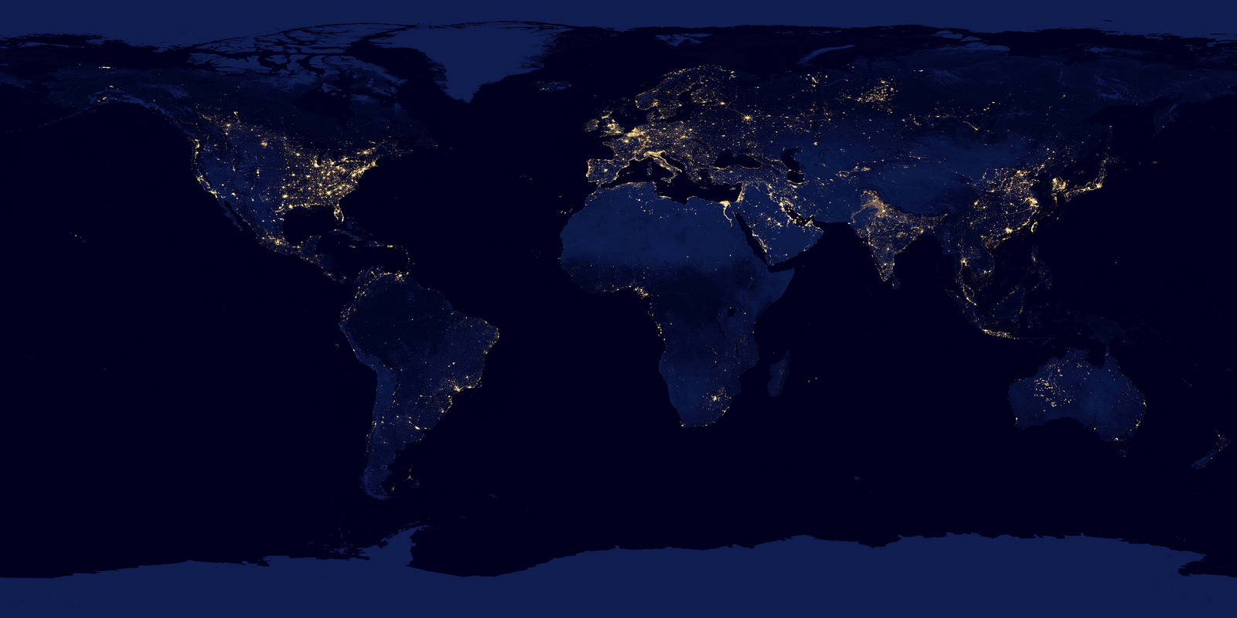
KMTNet: construction & installation
Cerro Tololo Ineramerican Observatory
Chile
South African Astronomical Observatory
South Africa
Siding Spring Observatory
Australia
Telescope:
05 - 2014
CCD:
09 - 2014
Telescope:
08 - 2014
CCD:
12 - 2014
Telescope:
11 - 2014
CCD:
05 - 2015

Slide 3
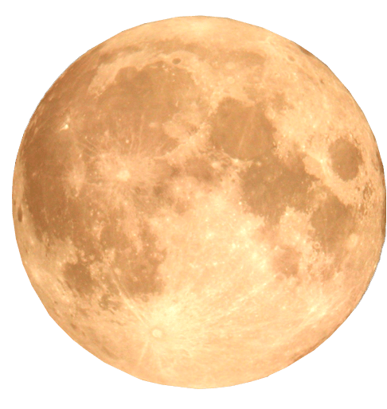
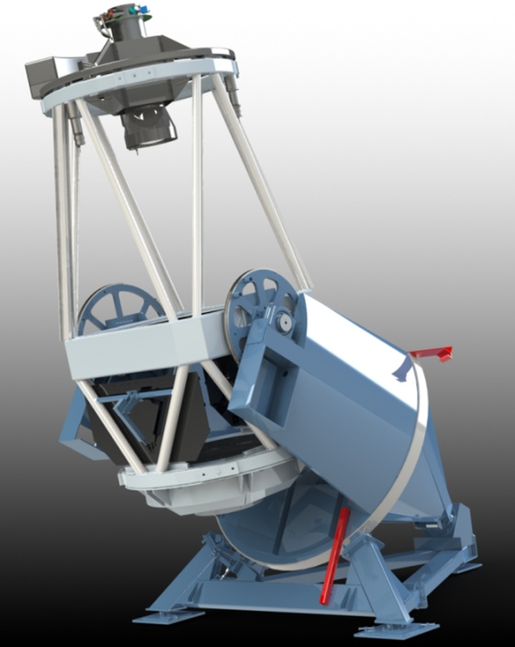
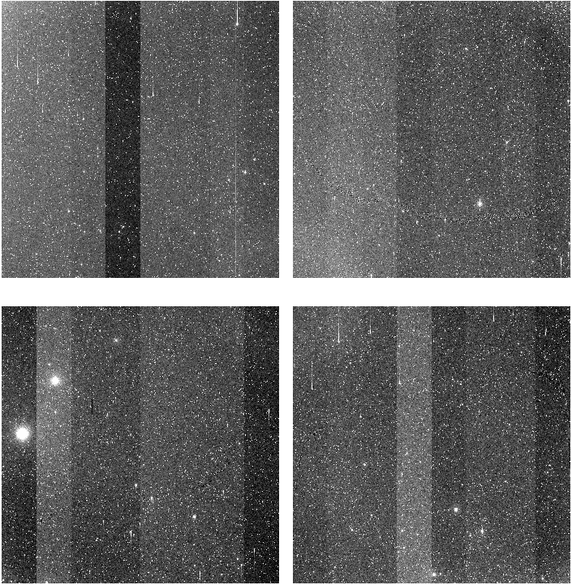
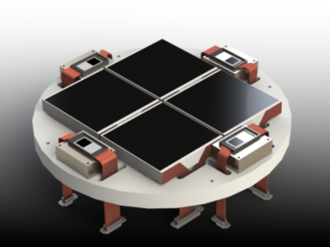
KMTNet: hardware system
3× 1.6 m
4× 9k chips: 18k× 18k CCD
4 □°
0."4 /pixel
1" fwhm @0."75 seeing
QE >85% in V-band

Slide 4
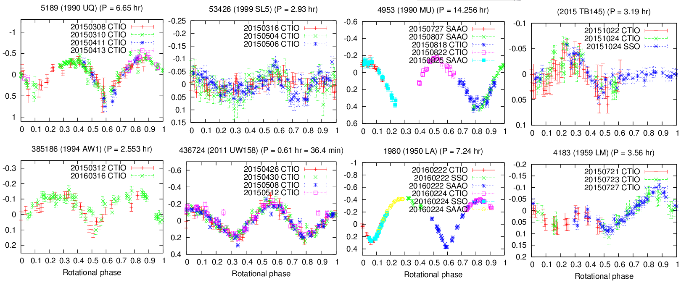
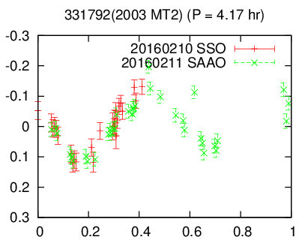
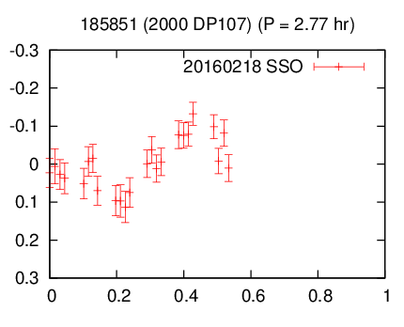
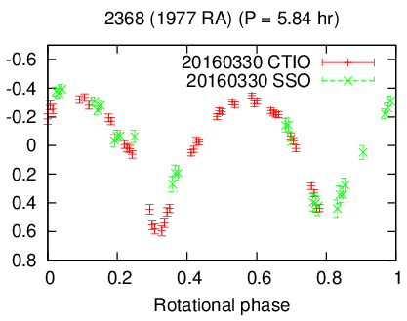
OC: light curves
Kim, in preparation

Slide 5
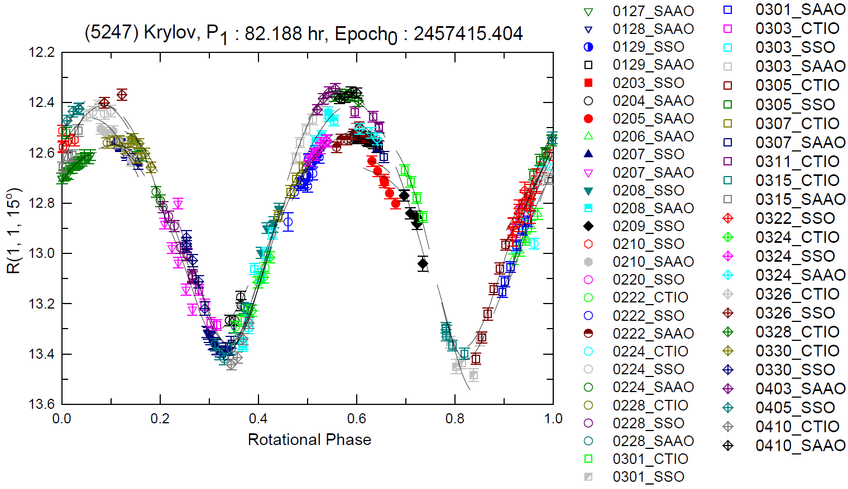
TO: NPA rotator
(5247) Krylov: lightcurve, physical parameters & convex model
fitted parameters
$λ_{L}$ [°] | $$294$$
$β_{L}$ [°] | $$−60$$
$P_{ψ}$ [h] | $$374.6$$
$P_{φ}$ [h] | $$67.48$$
$t_{0}$ | $$2457415.4$$
$φ_{0}$ [°] | $$67$$
$ψ_{0}$ [°] | $$336$$
$I_{a}$ | $$0.43$$
$I_{b}$ | $$0.94$$
derived parameters
$I_{a_shp}$ | 0.41
$I_{b_shp}$ | 0.93
Equatorial Plane View
Equatorial Plane View
Lee+ 17; Lee, in preparation

Slide 6
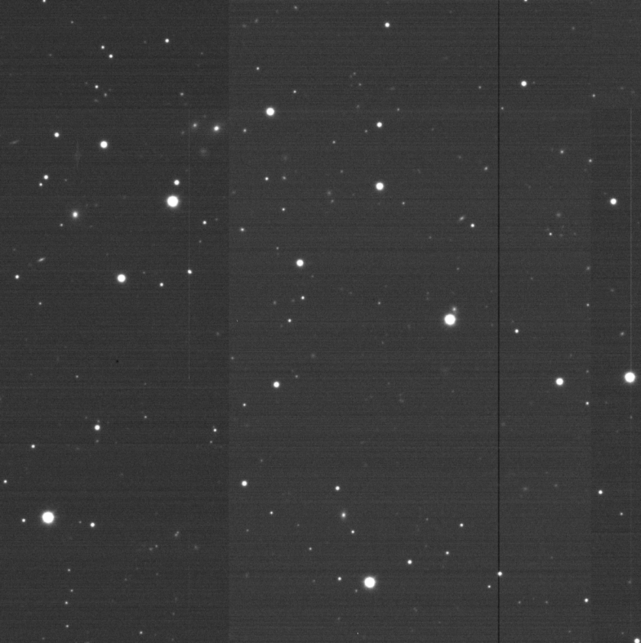
TO: IAWN perspective - 2012 TC4
“IAWN” follow-up photometry
period: 10-12 October 2017
facility: KMTNet-SSO & SAAO
1.6 m + 18k mosaic CCD
data share: w/ Erasmus+ @SAAO
Prepared by D-H Kim

Slide 7
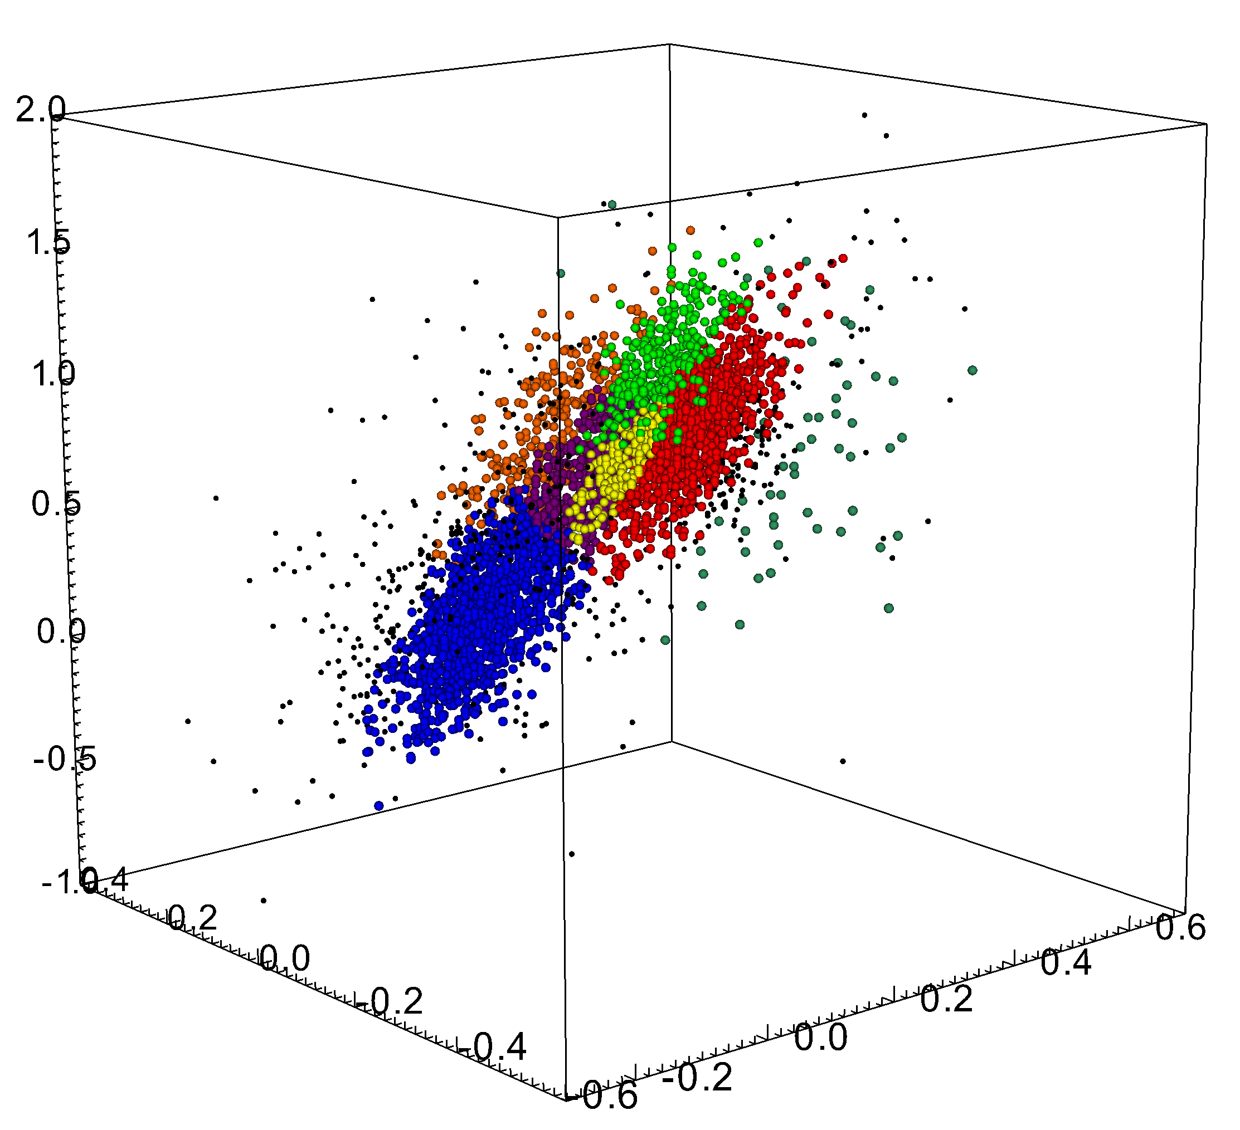
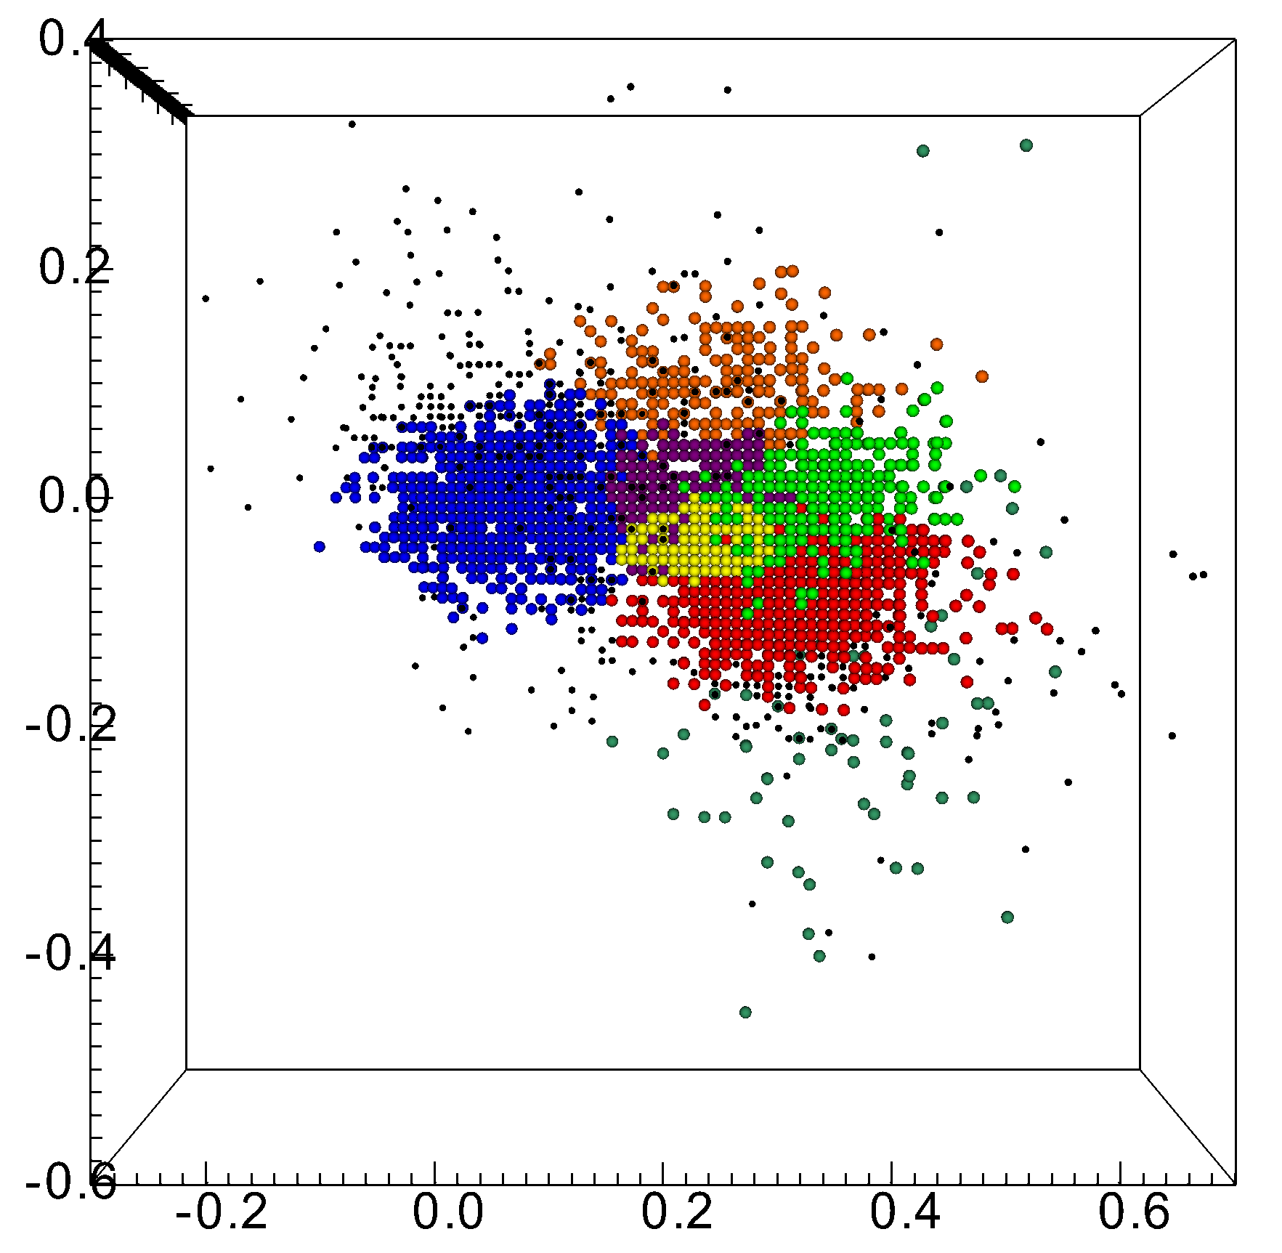
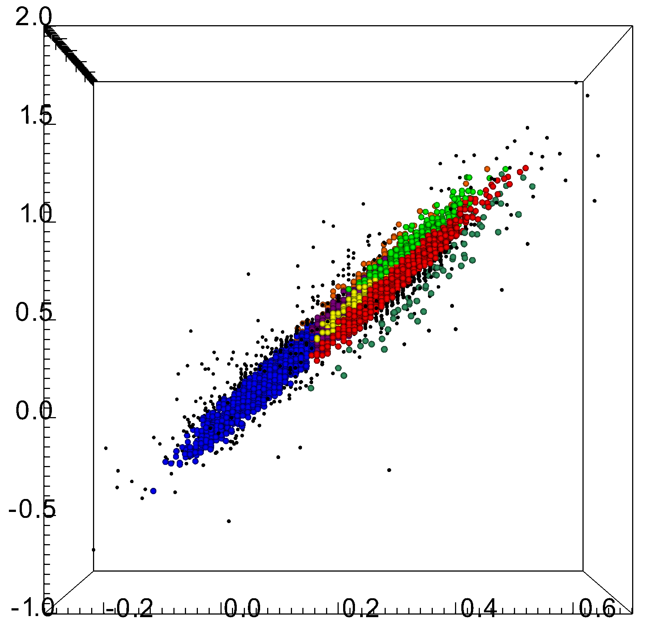
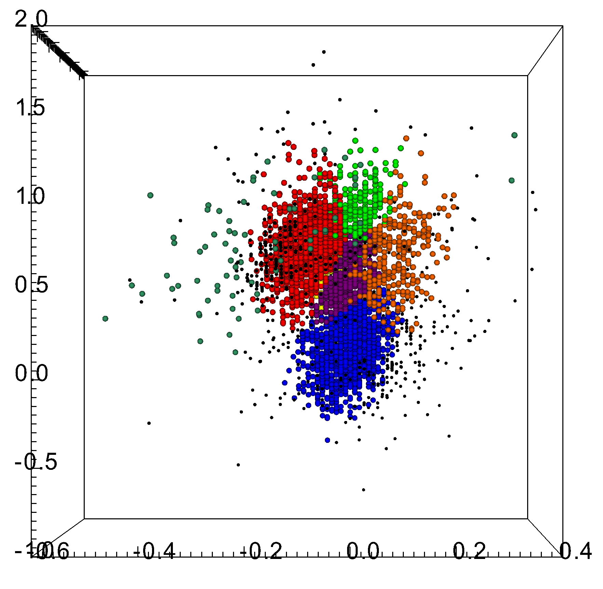
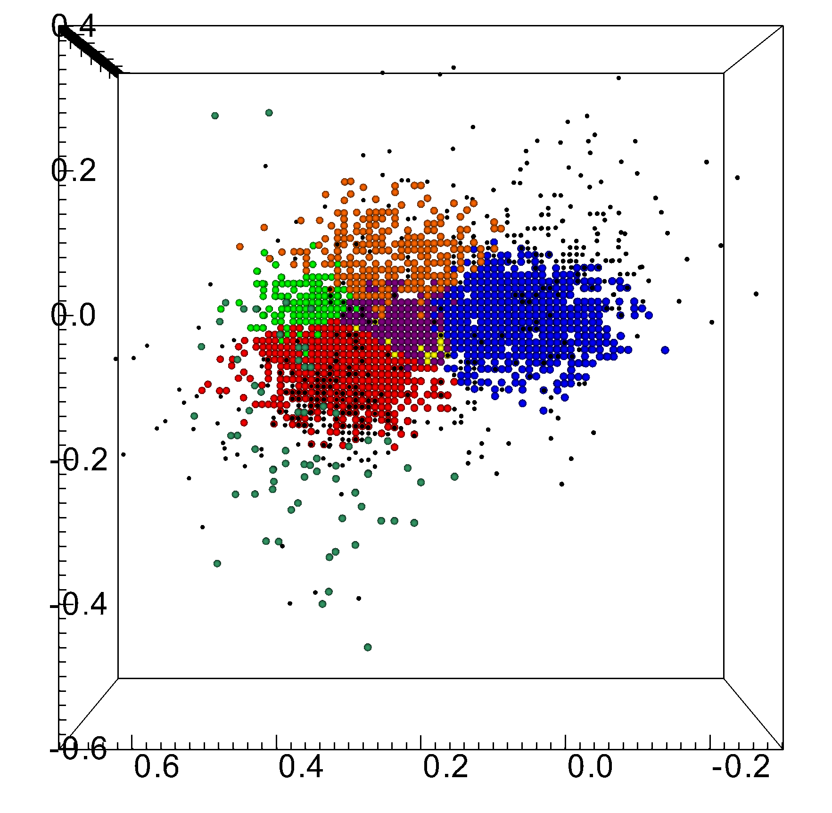
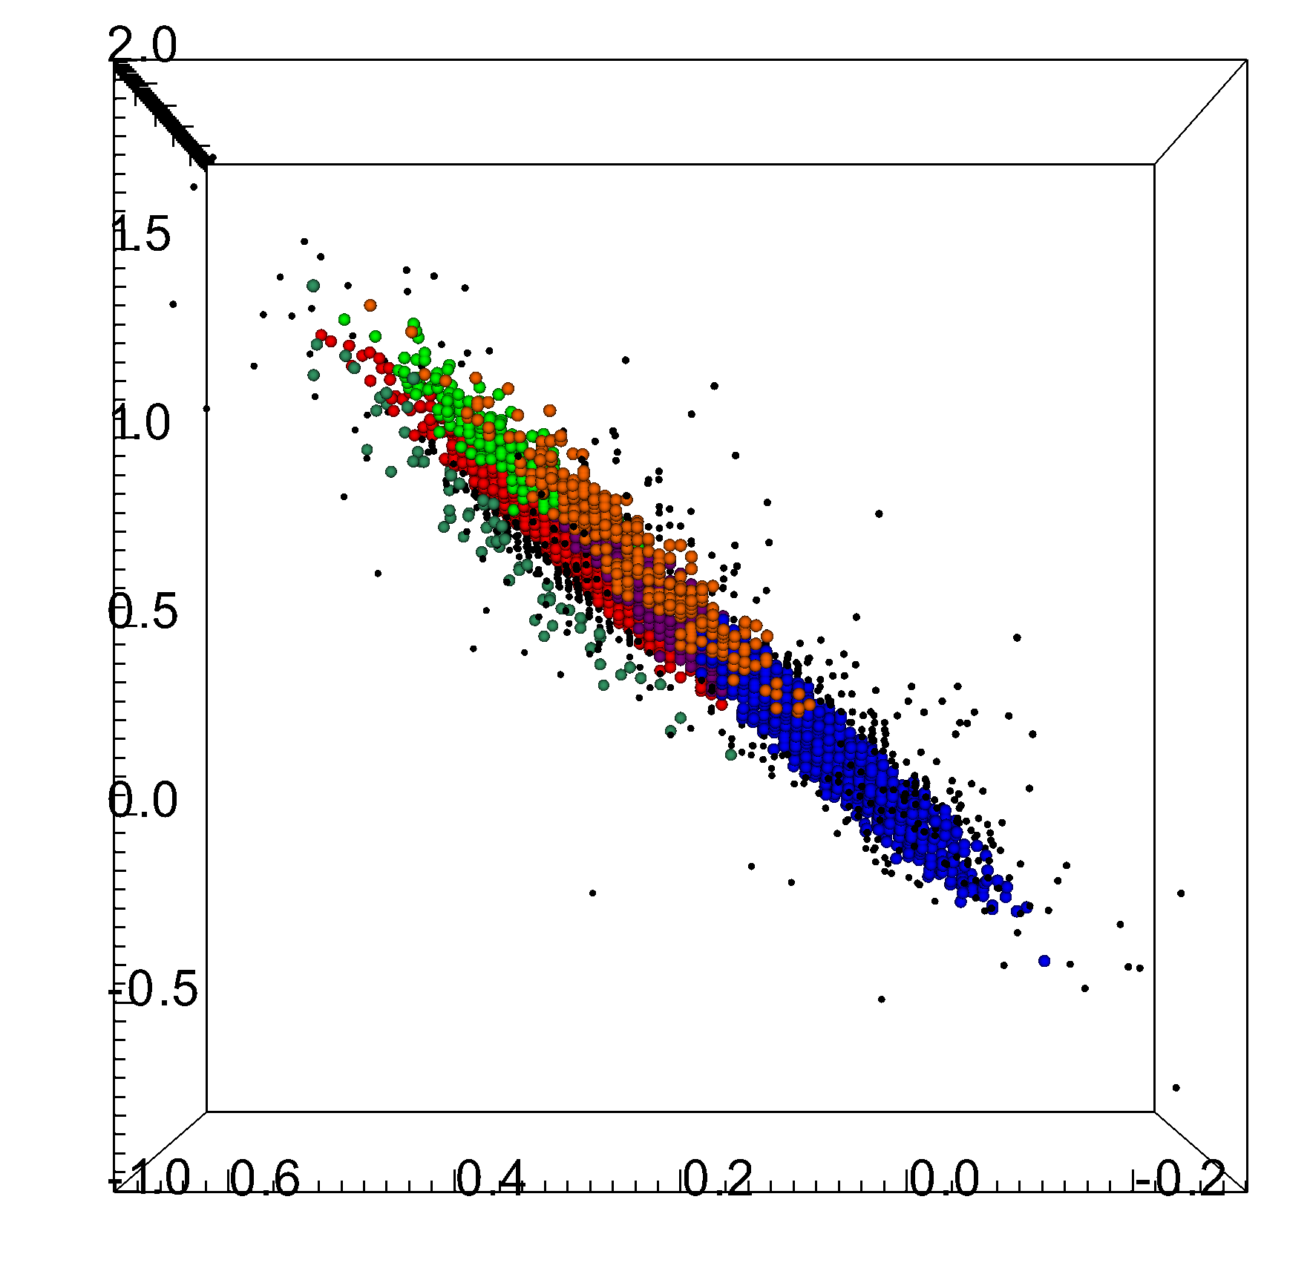
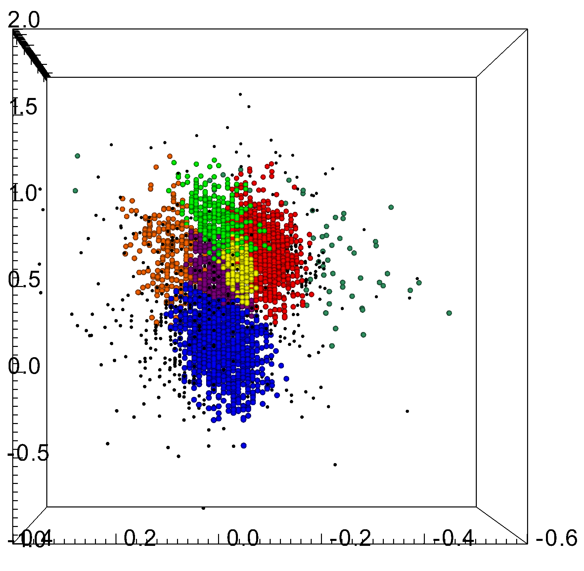
3D taxonomy: IAWN perspectives
1
MOC 4 + DeMeo & Carry dataset
DeMeo +09
0.44~1.10 µm
~400 VIS-NIR reflectance spectra
4
6
griz color
5
3
i - z
2
g - i
complex |  | g – i | i - z | griz
S-complex |  | 0.32235 | -0.09155 | 0.78526
X- | X-type | 0.21891 | -0.00426 | 0.58351
 | D-type | 0.24405 | 0.08177 | 0.70761
 | K-type | 0.26734 | -0.04733 | 0.69763
 | L-type | 0.34114 | -0.00564 | 0.93358
C-complex |  | 0.05941 | -0.00225 | 0.16325
V-type |  | 0.36092 | -0.20398 | 0.73925
1
3
5
i - z
griz color
griz color
2
g - i
4
g - i
6
i - z
i - z
griz color
griz color
Roh, in preparation

Slide 8
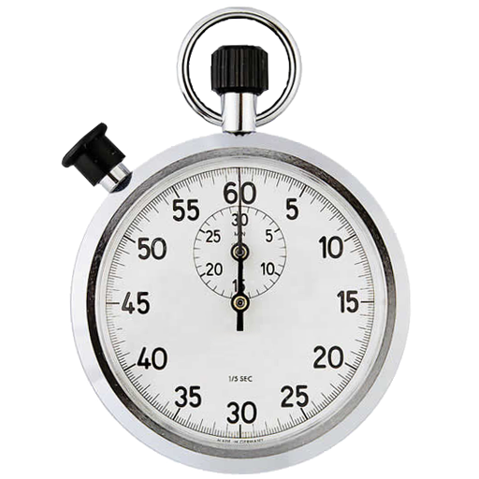
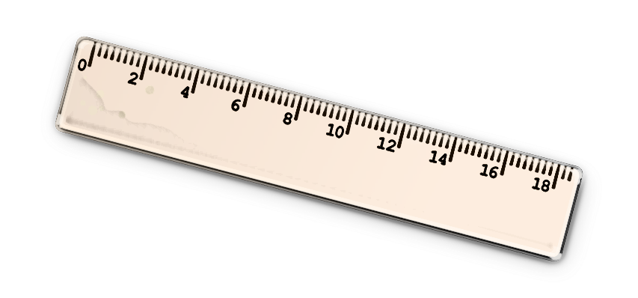
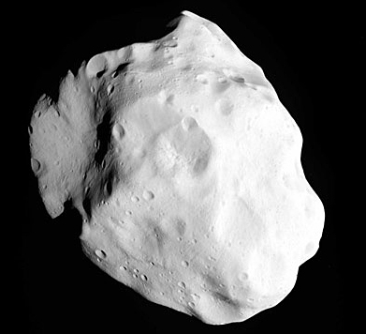
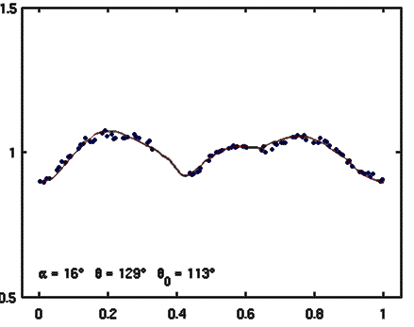
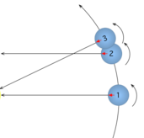
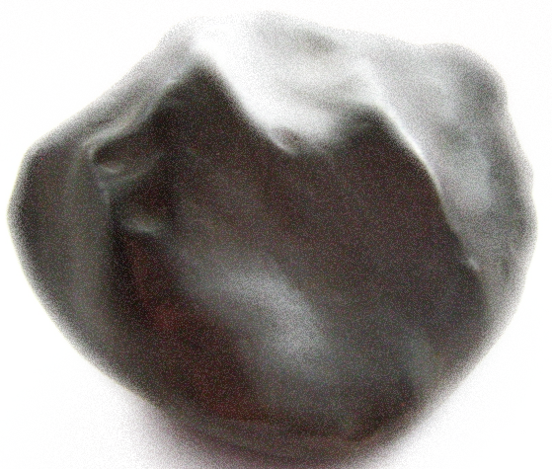
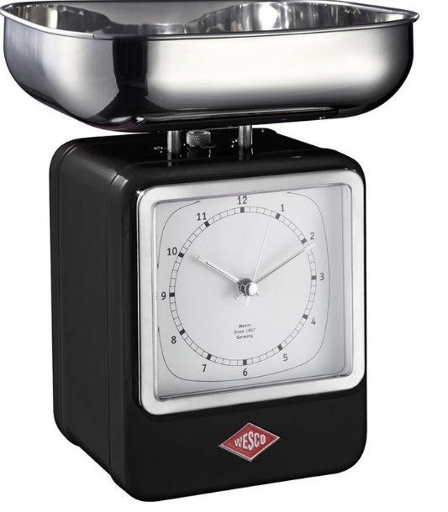
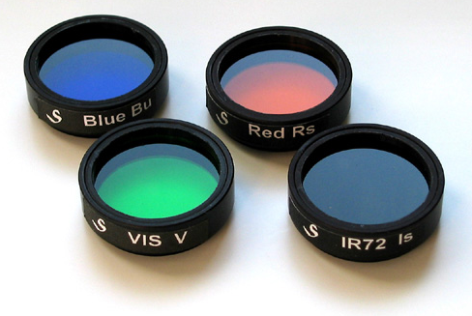
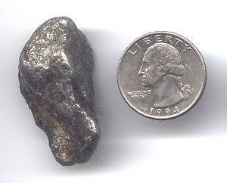
Characterization: IAWN perspectives
ESA; DAMIT; Simone Marchi

