Slide 1
Compliance Requirements for Students in the Communication Sciences and Disorders Graduate Program
For compliance questions
Email: CHS-Compliance@uky.edu
https://chs.uky.edu/current-students/compliance
C.T. Wethington Building Room 111

Slide 2
Requirements
Full Background Check
10 Panel Drug Screening
Clinical Requirements:
Health Insurance (annual)
Professional Liability Insurance
CPR Certification (Basic Life Support for Healthcare Providers)
Influenza Shot (annual)
TB: IGRA, QuantiFERON Gold or T-Spot Blood Test (annual)
Hepatitis B, MMR, Varicella and Tdap documents
Commitment to Behavioral Standard in Patient Care
Discrimination and Harassment Training
HIPAA training
Standards Acknowledgements
Handbook
CSD Clinic Manual
Personal Phone Usage
CSD Dress Code
Bloodborne Pathogen Exposure Policy
*THESE REQUIREMENTS MUST BE COMPLETED PRIOR TO STARTING CLASSES IN JUNE FOR ALL STUDENTS.

Slide 3
How to get started: Create an account on Castle Branch

Slide 4
Due Dates
The full background check and drug screening are due BY May 15th before class registration and start of program.
The clinical requirements are due by June 1st each year you are in the program.
Flu Immunization is due November 1st each year.
It is highly recommended that you do not wait until close to the deadline to complete these requirements. Get them done as early as possible in case problems arise!

Slide 5
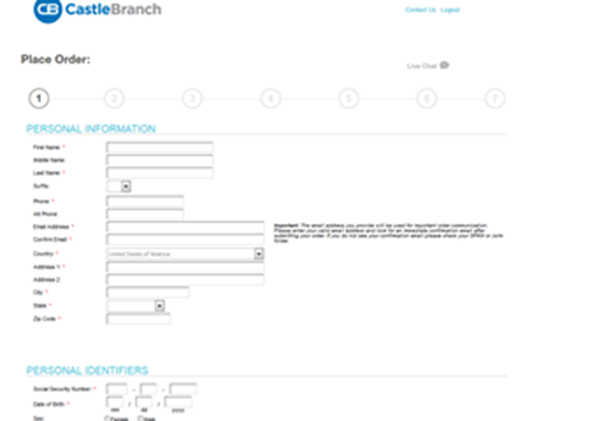
New to UK: CSD Grad Students follow these instructions below:
Go to: http://uky-health.castlebranch.com
Select “Place Order”
Select “College of Health Sciences”
Select “Communication Science and Disorders – Graduate”
Select “I need to order my initial Background Check, Drug Test, and Medical Document Manager”
You will then be directed to review your order, and then enter your personal details .
The cost is $103.00.

Slide 6
Background Check and Drug Screening
Your background check will begin immediately upon purchasing.
Instructions for your Drug Screening will be provided within your “To Do List” within three business days. You must use a LabCorp location for your drug screening.
You will be able to download the registration form and locate a LabCorp near you to process the specimen. It is your responsibility to make sure that you allow enough time for us to receive the result prior to the start of courses.
For issues processing a drug screen, please call CastleBranch directly at (888)723-4263

Slide 7
Clinical Requirements
Health Insurance (annual)
Professional Liability Insurance
CPR Certification (Basic Life Support for Healthcare Providers).
Influenza Shot (annual)
TB IGRA, QuantiFERON GOLD or 2 step TB skin test.
annual renewal
Hepatitis B, MMR, Varicella and Tdap documents
Commitment to Behavioral Standard in Patient Care
Discrimination and Harassment Training
HIPAA training
Bloodborne Pathogens Training

Slide 8
Required Immunizations
Required Vaccines : please obtain documentation from your healthcare provider.
TB: IGRA, QuantiFERON Gold or 2 Step TB skin test (annual update)
Hepatitis B
MMR,
Varicella
Tdap
Flu Immunization (annual update)
Vaccines can be administered by University Health Services (UHS)
Appointments may be made by calling 859-323-2778.

Slide 9
Health Insurance
You must provide a copy of your current health insurance card (front and back). .Please make sure your name is on the card.
If your name is different than the name listed on the card, you will need to upload documentation confirming your coverage along with a picture of the front and back of your insurance card. All documents must be uploaded as 1 upload.
Make sure that you upload a copy of the front AND back of the insurance card and any other documents needed as 1 upload.
Example of uploaded card:

Slide 10
Professional Liability Insurance
Students are responsible for obtaining their own liability insurance. Popular insurers include Proliability and HPSO.
The “Per Incident” amount should be at least 1 million and the “annual aggregate” should be at least 3 million. 2 million per incident and 4 million annual aggregate is also acceptable.
Typically costs $30-$50 per year.
Must be renewed annually.

Slide 11
MMR Vaccine
MEASLES, MUMPS AND RUBELLA (MMR) vaccine Compliance can be obtained by providing: 1. Two MMR vaccines with first dose given at 1 year of age or older AND second dose given at age four or older; OR 2. Documentation of positive antibody titers showing proof of immunity for each of the three diseases: [measles (rubeola), mumps AND rubella] Note: If a student submits documentation of negative or indeterminate titers, but they have also submitted proof of two MMR vaccines as listed above, this is acceptable. Documentation must include: Student’s Name Student’s date of birth If series is completed, dates of each shot OR If titers are provided, dates of positive titers are required and information will include: “immune,” “positive” or number that when compared to range given on record indicates the student is positive/immune; AND Name of the healthcare provider OR UHS compliance form OR Employee compliance form OR state immunization certificate or registry.

Slide 12
VARICELLA (Please note that oral history of disease or an X on immunization record is not accepted.) Compliance may be obtained by providing: 1. Evidence of varicella two-dose series after one year of age; OR 2. Positive antibody titer showing proof of immunity; OR 3. Medically documented history of disease (chicken pox/varicella or shingles/zoster) from a healthcare provider (Doctor, APRN, or PA) with date of disease. An X on the immunization form by varicella is NOT acceptable proof of disease. Note: If a student submits documentation of negative or indeterminate titers, but they have also submitted proof of two varicella vaccines as listed above, this is acceptable
Documentation must include: Student’s Name Student’s date of birth If series is completed, dates of each shot; OR If titer is provided, date of positive titer is required and information will include: “immune,” “positive” or number that when compared to range given on record indicates the student is positive/immune; OR
If providing medical history, submit a medical record from healthcare provider (Physician, APRN or PA) stating patient diagnosed with Chicken pox (Varicella) or Shingles (Herpes zoster); AND Name of the healthcare provider OR UHS compliance form OR Employee compliance form OR state immunization certificate or registry.

Slide 13
HEPATITIS B (Positive titer not accepted)
Compliance may be obtained by providing: 1. Evidence of three Hepatitis B vaccines; OR 2. If series is in process or historical documentation of vaccines could not be obtained, 2 vaccines are required upon initial submission to this requirement. You will be able to submit record of the third shot when it is due. Documentation must include: Student’s Name Student’s date of birth Dates of HEP B shots; AND Name of the healthcare provider OR UHS compliance form OR Employee compliance form OR state immunization certificate or registry. Subsequent Requirement: If only two initial vaccines obtained, Hepatitis B third dose due 6 months after the 1st dose.

Slide 14
Evidence of one dose of TDaP given at any date. Documentation must include: Student’s Name Student’s date of birth Date of TDaP shot Name of the healthcare provider OR UHS compliance form OR Employee compliance form OR state immunization certificate or registry.
TDaP
(Tetanus-Diphtheria Acceular Pertussis)

Slide 15
Tuberculosis Test
TB: One of the following is required to complete the TB requirement.
IGRA, QuantiFERON GOLD or 2 Step TB Skin test (2 TB skin tests given at least 1 week apart).
Must be updated annually.
TB Blood tests or TB skin tests can be completed at University Health Services or any other locations where offered. If completed at UHS, your document will automatically be uploaded in your MyChart in your myUK.
TB Tests do not have to be completed at UHS, but all TB documentation must be kept and uploaded to your Castlebranch Account

Slide 16
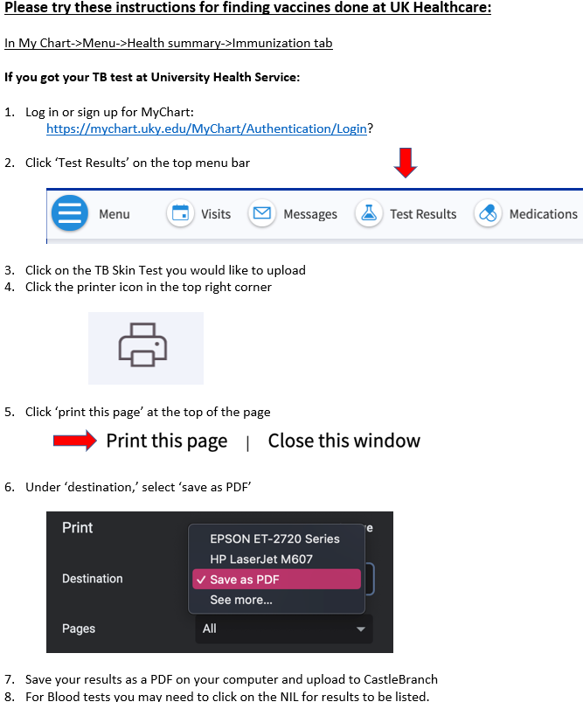
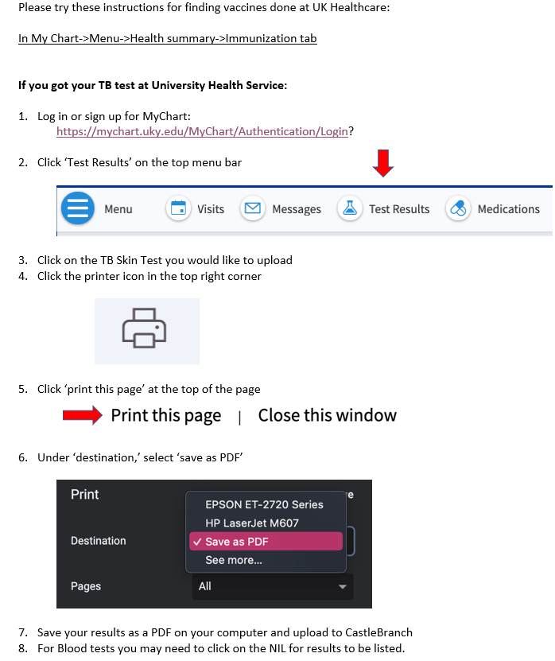

Slide 17
Influenza Vaccination
You will need to get a flu shot for the CURRENT FLU SEASON SEPT 1 – MARCH 31.
Please follow these instructions below for finding vaccines done through UK Healthcare:
Login to your My Chart:
https://mychart.uky.edu/MyChart/Authentication/Login
Go to Menu
Health summary
Immunization tab
Click the printer icon
Under destination, save as a PDF on you laptop
Upload to your CastleBranch account.
Any flu shot administered outside of this window for the current flu season will be rejected.
If flu immunization is completed on UK Campus, your document will automatically be uploaded in your MyChart in your myUK
This requirement has a different deadline than the others. You must complete this by November 1st.

Slide 18
Commitment to Behavioral Standard in Patient Care
In Castle Branch, there is a link to this document. Follow this link to go to the document:
https://chs.uky.edu/current-students/compliance/forms
You will need to print, read, and sign this document.
Then, scan it and upload it to Castle Branch (there are scanner apps you can download for free on your phone.)

Slide 19
BLS/CPR Certification
Acceptable documents:
American Heart Association Basic Life Support OR
American Red Cross BLS/CPR for Healthcare Providers
Must be an in-person course (not online)
A copy of BOTH the front and the back of your card is required and the card MUST be signed.
More information can be found at the following links:
http://www.redcross.org/take-a-class/bls
http://cpr.heart.org/AHAECC/CPRAndECC/Training/HealthcareProfessional/BasicLifeSupportBLS/UCM_473189_Basic-Life-Support-BLS.jsp

Slide 20
HIPAA and Discrimination and Harassment Trainings
Go to this link and enroll in the Canvas course. (NOTE: You will need your LinkBlue ID and password to do so. If you do not yet have it, you will have to wait until you do.)
Go to “Assignments.” You will find the HIPAA training presentation and quiz. Before beginning the quiz, carefully read and review all the information in the presentation. When you are familiar with the material, take the quiz. You will have multiple attempts, but you MUST receive a 100% in order to get credit.
Follow the same instructions for the Discrimination training.
When both are complete, go to the “Grades” tab. You will then select the “Print Grades” option. Save the document as a PDF (you only need the first page that displays the two grades and your name).
Upload this PDF for BOTH the HIPAA and Discrimination training requirements in Castle Branch.

Slide 21
The document you upload for the HIPAA and Discrimination training should look like this:

Slide 22
Policy and Standard Acknowledgements
This portion will be completed at CSD Orientation, where you will be given the CSD Clinic Manual.
For each of the following, carefully read and review the pertinent information in the CSD Clinic manual, which you will receive at orientation, and confirm that you have read and understand them.
Student Handbook
CSD Clinic Manual
Personal Phone Usage
CSD Dress Code
Bloodborne Pathogen Exposure Policy

Slide 23
Important Notes
Pay attention to due dates! If you do not complete the requirements in time, a hold will be placed on your UK account.
If CastleBranch rejects one of your submissions, promptly address this. Castlebranch will provide a reason for the rejection in an email to you. If you still do not understand why a document is not being accepted, you can contact:
CHS-Compliance@uky.edu
Occasionally, flu shots get rejected if the flu season is not explicitly stated on the document. Make sure your name, birthdate and date given is also listed on the document prior to uploading. Check your CB account to see what reason your flu shot is rejected.
Note that the flu shot has a different deadline than the other requirements and is due November 1st.

