Slide 1
Compliance Requirements for MLT to MLS Majors
For compliance questions
Email: CHS-Compliance@uky.edu
https://chs.uky.edu/current-students/compliance
C.T. Wethington Building Room 111

Slide 2
Clinical Requirements
Full Background Check
10 Panel Drug Screening
Clinical Requirements:
Health Insurance (annual)
Influenza Shot (annual)
Tuberculosis Two-Step Skin Test (initial) OR IGRA Blood Test
-One step Skin test or IGRA Blood test for annual renewal
Immunizations: Hepatitis B, MMR, Varicella and Tdap documents
Commitment to Behavioral Standard in Patient Care
HIPAA Training
Discrimination and Harassment Training

Slide 3
Due Dates
The full background check and drug screening are due September 1st.
The clinical requirements and trainings are due by October 1st.
The trainings will be due 2-3 weeks after orientation. You will receive more information about how to complete these at orientation.

Slide 4
How to get started: Create an account on Castle Branch

Slide 5
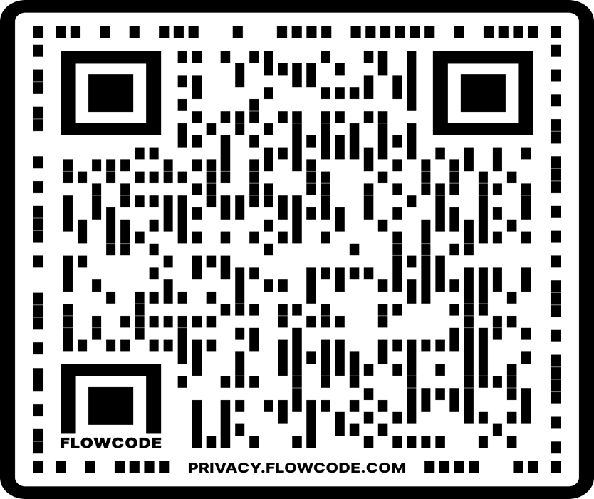
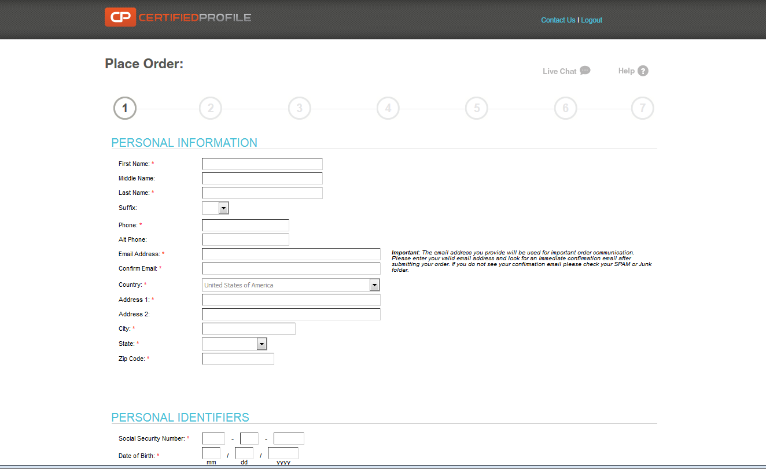
Go to: https://uky-health.castlebranch.com/UK33
or scan QR code
Click on “Place Order”
Select “Medical Laboratory Sciences”(Lexington campus)
Select : UK38online: MLT Online only (Background Check, Drug Test and Medical Document Manager)
You will then be directed to review your order, and then enter your personal details
The cost is $103.

Slide 6
Your background check will begin immediately upon purchasing.
Instructions for your Drug Screening will be provided within your Castle Branch “To Do List” within three business days. You will be able to download the registration form and locate a LabCorp near you to process the specimen. It is your responsibility to make sure that you allow enough time for us to receive the result prior to the start of courses.

Slide 7
Clinical Requirements
Health Insurance (annual)
Commitment to Behavioral Standard in Patient Care
Influenza Shot (annual)
Immunizations: Hepatitis B, MMR, Varicella and Tdap documentation
Tuberculosis Two-Step Skin Test (2 separate TB tests given at least 1 week apart) or IGRA Blood Test
An annual one-step skin test or IGRA Blood test is required the following year for renewal.

Slide 8
Required Immunizations
Required Vaccines : please obtain documentation from your healthcare provider.
TB: 2 step TB test (2 separate TB skin tests given at least 1 week apart) or QuantiFERON blood test.
Hepatitis B
MMR,
Varicella
Tdap

Slide 9
Health Insurance
You must provide a copy of your current health insurance card or proof of coverage.
Please make sure your name is on card. If your name is different than the name listed on the card, you will need to upload documentation showing you are covered under the name listed on the card, along with a copy of the front and back of your insurance card.
Make sure that you upload a copy of the front AND the back of the insurance card and any other documents needed as 1 upload/submission.

Slide 10
Influenza Vaccination
You will need to get a flu shot for the current flu season SEPT 1 – MARCH 31.
Any flu shot administered outside of the current flu season will be rejected
This document is due no later than November 1st.
Note that this document will look a little different depending on where you get your flu shot.
(must renew every year)

Slide 11
Tuberculosis Test
New MLT to MLS students are required to complete an initial two-step TB skin test (2 separate TB skin tests given at least one week apart) or equivalent IGRA Blood test.
TB skin tests can be completed at University Health Services free with student ID. If you have had a TB test within the last year, please bring a copy of the results with you to your appointment
2 step TB test required or IGRA Blood test!

Slide 12
Commitment to Behavioral Standard in Patient Care
In Castle Branch, there is a link to this document. Follow this link https://chs.uky.edu/current-students/compliance/forms
You will need to print, read, and sign this document. Then, scan it and upload it for the requirement.

Slide 13
HIPAA and Discrimination and Harassment Trainings
Go to this link: https://uk.instructure.com/enroll/93PGHL
Enroll in the Canvas course. (NOTE: You will need your LinkBlue ID you will need your password to do so. If you do not yet have it, you will have to wait until you do.)
Go to “Assignments.” You will find the HIPAA training presentation and quiz. Before beginning the quiz, carefully read and review all the information in the presentation. When you are familiar with the material, take the quiz. You will have multiple attempts, but you MUST receive a 100% in order to get credit.
Follow the same instructions for the Discrimination training.
When both are complete, go to the “Grades” tab. You will then select the “Print Grades” option. Save the document as a PDF (you only need the first page that displays the two grades and your name).
Upload this PDF for BOTH the HIPAA and Discrimination training requirements in Castle Branch.

Slide 14
The document you upload for the HIPAA and Discrimination trainings should look like this:

Slide 15
Important Notes
Pay attention to due dates! If you do not complete the requirements in time, a hold could be placed on your UK account.
If Castle Branch rejects one of your submissions, promptly address this. They will provide a reason for the rejection. If you still do not understand why a document is not being accepted, you can email CHS-Compliance@uky.edu
Occasionally, flu shots get rejected if the flu season is not explicitly stated on the document. It is required for the date to be listed and on the document prior to uploading. CHECK FIRST in your CB account, to see if this is the reason a flu shot is rejected.

